Slide 1
Domain and Range
Integrated Mathematics

Slide 2
Objectives
Students will be able to:
1. identify the domain and range of a relation.
2. show relations as sets and mappings.

Slide 3
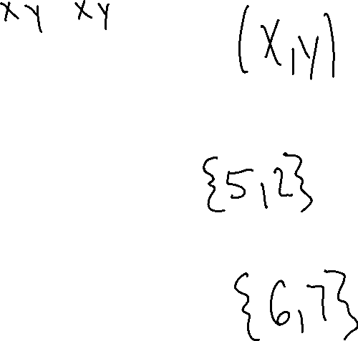
Definitions
A relation is a set of ordered pairs.
    {(5,6),(2,7)}
The domain of a relation is the set of all its x-coordinates.
The range of a relation is the set of all its y-coordinates.

Slide 4
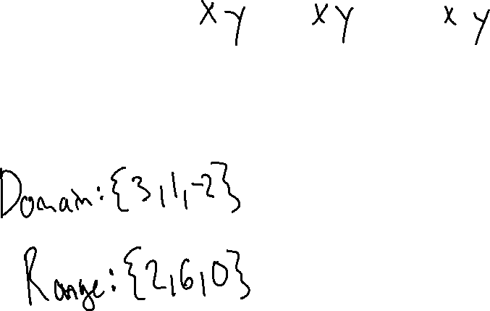
EX. 1)
Given the relation {(3,2), (1,6), (-2,0)}, find the domain and range.

Slide 5
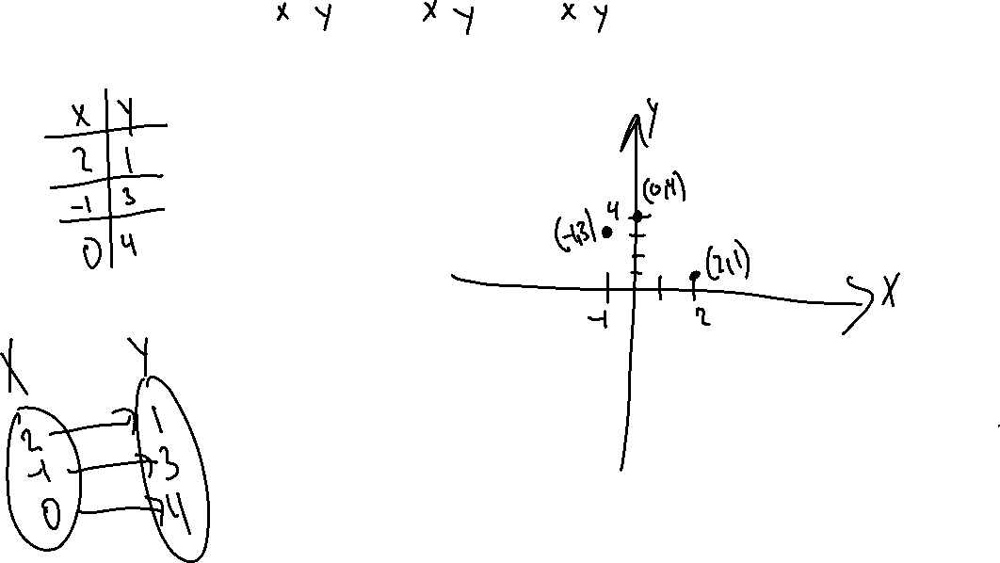
The relation {(2,1), (-1,3), (0,4)} can be shown by
1) A Table
2) A Mapping
3) A Graph

Slide 6
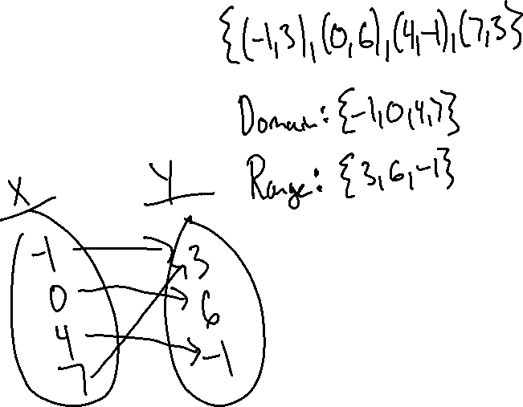
Ex.2)
Given the following table, show the relation, domain, range, mapping.
x -1 0 4 7
y 3 6 -1 3

Slide 7
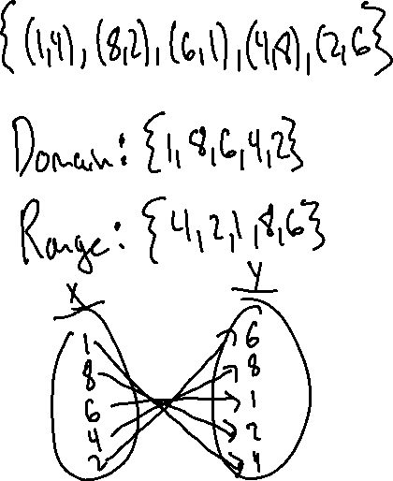
Ex. 3
Write the relation, domain, range, and mapping from the given table.
X | Y
1 | 4
8 | 2
6 | 1
4 | 8
2 | 6

Slide 8
Try These
Write the domain, range, relation, graph, ordered pairs, and mapping of the following table.
X | Y
7 | 5
7 | 1
7 | 9
5 | 6
5 | 3
X | Y
3 | -1
5 | 8
1 | -6
0 | 5
9 | 3
X | Y
-5 | 3
6 | 3
5 | 3
-5 | 6
8 | 9

